Slide 1

Activity: Ice Breaking
In this activity, you will perform the following task:
  Introduce your friend
Notes:
Encourage students to speak about themselves briefly. However, remind the students to convey useful information about themselves in less time.

Slide 2
Course Rationale
Communication is an indispensable part of our lives. As a matter of fact, it is absolutely essential for the sustenance of human beings.
In today’s age, merely communicating is not enough. You need to be able to communicate your ideas and thoughts in such a way that it leaves an everlasting effect on the minds of the people. This module will enable you to enhance your communication skills so that you can convey your feelings and ideas the way you want to.

Slide 3
Objectives
In this session, you will:
  Define the term communication
  Understand the process and elements of communication
  Identify the types and medium of communication
  Understand the behavioral patterns in communication
  Identify and classify the barriers to communication
  Appreciate the rules for overcoming barriers
  Understand the importance of effective communication
Notes:
This course focuses on improving your communication skills. It begins with an introduction to communication and then move on to develop presentation skills. Further, it emphasizes on active listening skills and the importance of telephone etiquettes. In addition, it focuses on improving writing skills, questioning and paraphrasing, and using appropriate words in communication.

Slide 4

What is Communication?
Communication:
  Is a process of sharing information, ideas, facts, or emotions.
  Is done to build relationships with people.
  Is done by using symbols, gestures, sounds, letters, numbers, and words.
  Is effective when the communicating parties are able to comprehend the intended message.
Notes:
Make the students understand that even simple instructions can be misinterpreted, especially if the recipient does not (or cannot) ask for clarification.

Slide 5
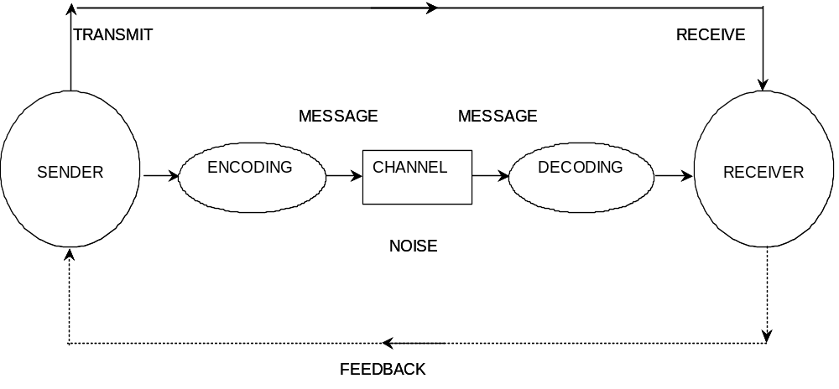
Process of Communication
The following figure shows the process of communication.
Notes:
Relate the five elements in the communication process to each other. Emphasize on how noise and other factors effect communication.

Slide 6

What is Effective Communication?
Effective communication involves the following steps:
  A person sends a message.
  Another person receives the message.
  The receiver partly or wholly understands the message.
  The receiver responds to the message, that is, there is some kind of feedback.
Effective communication also requires appropriate emotions.
Notes:
Note: Communication transmits information consisting not only of tangible facts, determinable ideas, and opinions, but also of emotions. While transmitting information, the communicator conveys the attitude or frame of mind either consciously or unconsciously. Sometimes, high praises are spoken in a scoffing tone. In such situations, not only words but the tone also matters. Similarly, high-sounding expressions may conceal a person's timidity and cowardice, which may be betrayed by facial expressions.

Slide 7
Elements of Communication
The elements of communication are:
  Confidence
  Conviction
  Enthusiasm

Slide 8
Types of Communication
Communication can be:
  Impersonal: Refers communication that involves paperwork.
  Personal: Refers communication that involves face-to-face or telephonic conversation. It is categorized into:
    Verbal
    Non-verbal

Slide 9
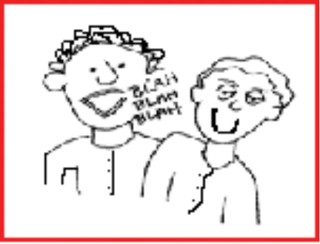
Types of Communication (Contd.)
Effective verbal communication requires:
  Sending clear and concise message.
  Listening and understanding the conveyed message correctly.
Effective verbal communication:
  Is brief, clear, and organized.
  Is free of jargon.
  Does not create any resistance in the mind of listener.
Notes:
You may use this example, Seema is not paying attention towards her work. Ravi, as a team leader, wants to convey the message to his manager. While informing his manager, Ravi uses the following statement to avoid resistance in his manager’s mind:
“You may know that Seema is paying less attention towards her work, which might affect the project deadlines.”
Further, listening to the message is another part of verbal communication. Listening to a disorganized message is tedious and the message loses its impact. However, to understand the message, you need to listen to the message actively and understand the relevance of the message. Therefore, in verbal communication, you need to choose appropriate words that are clear and concise.

Slide 10

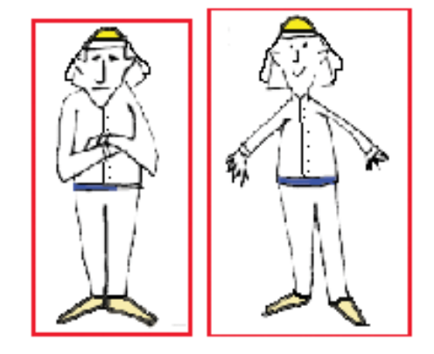
Types of Communication (Contd.)
Non-verbal communication consists of:
  Kinesics: Gestures, postures, facial expressions.
  Proxemics: Physical distance that is maintained while talking to a person.
  Paralanguage: The manner in which you say something rather than the words you speak.
Notes:
Note: It has been observed that 55 percent of communication is based on non-verbal clues, such as facial expression and body language. Voice intonation, which includes tone, tempo, pitch, and volume, makes up 38 percent of our communication, while actual words account for only 7 percent of communication.

Slide 11
Activity: Interpretation of Non-verbal Communication
In this activity, you will perform the following task:
  The following table lists common interpretations of non-verbal communication. Check the most appropriate answer.
Crossed arms | Convinced | Defensive
Rubbing palms | Anticipation | Confident
Scratching head while talking | Confident | Nervous
Avoiding eye contact | Nervous | Suspicious
Running hands through the hair | Nervous | Frustrated
Hands in your back pocket | Confidence | Arrogance

Slide 12





Medium of Communication
Communication medium is classified into four groups:
  Written
  Oral
  Visual
  Audio-visual
Notes:
In a working environment, anything you do involve communication. You can communicate in different ways such as face-to-face, telephonic, and written.
In the process of communication, the medium of communication should be selected keeping the urgency of message, availability of time, and the expenditure involved, in mind.

Slide 13
Activity: Identify the Behavior
Sample Situations and Answers:
1. You are in a team lunch and someone starts smoking. Smoking offends you. You: Answer 1: Say “We are on a team lunch. Get out if you want to smoke!” Answer 2: Don’t say anything and quietly suffer the smoke. Answer 3: Say “I would appreciate if you avoid smoking here”
2. You are on the phone and someone is talking to you. However, the voice is not clearly audible. Answer 1: You strain yourself to listen and end up understanding nothing. Answer 2: You shout and say “I can’t hear you. Are you talking to yourself” Answer 3: You interrupt the person and say “Could you please be louder”

Slide 14

Behavioral Patterns in Communication
Different behavioral patterns in communication are:
  Passive
  Aggressive
  Assertive
Notes:
Explain that people having passive behavior get very easily influenced and are not great professionals.
People having aggressive behavior are the most dangerous communicators in a customer-centric organization.
People having assertive behavior have the best mindset in a customer-centric environment.

Slide 15

Improving Behavioral Pattern
Oops! I am aggressive. How do I change myself?
Notes:
For an aggressive person it is important to avoid fight. It prevents productive communication.

Slide 16
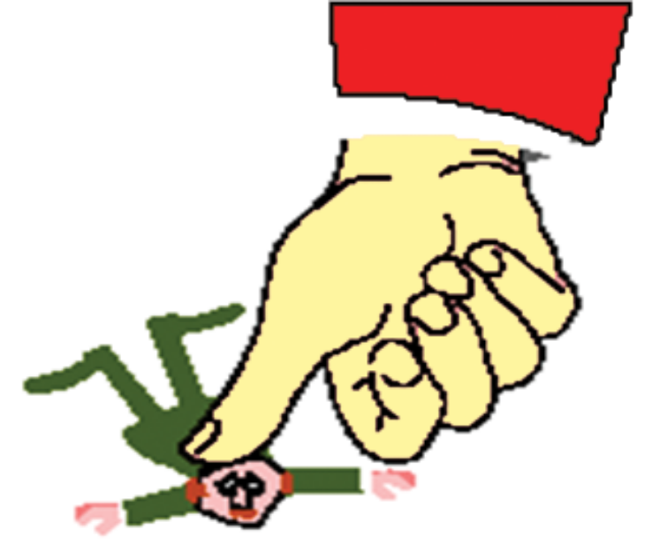
Improving Behavioral Pattern (Contd.)
Oops! I am passive. How do I change myself?
Notes:
Think before you compromise while dealing with aggressive persons.

Slide 17

Improving Behavioral Pattern (Contd.)
I am assertive. How do I remain same?

Slide 18

Barriers to Communication
Communication barriers means anything that prevents the sender or the receiver from understanding the message.
Communication barriers are classified as:
  Physical
  Semantic
  Socio-psychological
Notes:
Explain that in communication process, you need to avoid barriers. Barriers are erected consciously or unconsciously by the sender or the receiver.

Slide 19

Rules for Overcoming Barriers
Rules for overcoming barriers are:
  Create a plan.
  Clarify the ideas.
  Create an environment of assurance and confidence.
  Consider time while you communicate.
  Support your speech with action.
  Communicate efficiently.
  Ensure clarity in your message.
  Communicate by focusing the purpose.

Slide 20
Importance of Effective Communication in an Organization
Effective communication is critical to the success of an organization. This is because:
  Organizations are becoming more complex.
  Economic and market conditions are changing.
  Government legislation changes frequently.
  Workers are organized into trade unions.
  Employees expectations have increased.
Notes:
Note: Effective communication is important in both your personal and professional life. Communication skills are more important in careers that involve more of mental computations rather than manual labour. However, to grow in your professional life, it plays a vital role. Your job, promotion, and professional reputation often depend on your written and oral communication skills and expertise. Your progress will be strongly influenced by how effectively you communicate your knowledge, proposals, and ideas to others.

Slide 21
Importance of Effective Communication in an Organization (Contd.)
The following factors make communication effective at your workplace:
  Be clear about the objectives of communication.
  Organize the message.
  Suit your message to the needs of the receivers.
  Carefully select your medium.
  Be careful about timing the message.
  Remove the barriers to effective communication.
  Try to get feedback.

Slide 22

Importance of Effective Communication in an Organization (Contd.)
The seven C’s are:
  Credibility
  Context
  Content
  Clarity
  Channels
  Consistency
  Capability of the audience
The four S’s are:
  Shortness
  Simplicity
  Strength
  Sincerity

Slide 23
Summary
In this session, you learned that:
  Communication is the process of sharing information, through a common system of symbols, signs or behaviour, so that the sender and receiver have a common understanding.
  The elements involved in the process of communication are:
    Sender
    Message
    Medium
    Receiver
    Feedback
  The factors that influence effective communication are encoding, decoding, and noise.
Notes:
Use this and the following slides to summarize the session by using the key points mentioned in the slide(s).

Slide 24
Summary (Contd.)
  The elements of communication are:
    Confidence
    Conviction
    Enthusiasm
  Communication can be personal or impersonal.
  Personal communication involves the use of both verbal and non-verbal skills.
  The medium of communication can be written, oral, visual, or audio-visual.
  Different behavioral patterns in communication are:
    Passive behavior
    Aggressive behavior
    Assertive behavior

Slide 25
Summary (Contd.)
  Barriers are created consciously or unconsciously by the sender or the receiver. Barriers hamper the communication and degrades the status of the feedback.
  The types of communication barriers are:
    Physical
    Semantic
    Socio-psychological

Slide 26
Summary (Contd.)
  Rules for overcoming barriers are:
    Create a plan.
    Clarify the ideas.
    Create an environment of assurance and confidence.
    Consider time while you communicate.
    Support your speech with action.
    Communicate efficiently.
    Ensure clarity in your message.
    Communicate by focusing the purpose.
  Effective communication is critical to the success of an organization.

Slide 27
Summary (Contd.)
  Make your communication effective by following these factors:
    Be clear about the objectives of communication.
    Organize the message.
    Suit your message to the needs of the receivers.
    Carefully select your medium.
    Be careful about timing the message.
    Remove the barriers to effective communication.
    Try to get feedback.
  To make communication effective, the concept of seven C’s and four S’s are used.

